Slide 1

Allison Beatty
Ian Scarff
Sim Singh
Ileana Marcano
Notes:
Ian
“Good afternoon everyone, my name is Ian Scarff and today I am joined by my team Allison Beatty, Sim Sing(h is silent), and Ileana Marcano.”
“Today we will be discussing the Facebook dataset for mainstream news sources.”
Data set was created and previously used by Patrick Martinchek.

Slide 2















Notes:
Ian
It consists of posts from the top 15 mainstream news sources
The entire data set spans from January 1st 2012 to November 7th 2016, right before the 2016 election between Clinton and Trump
Each post has information attributed to it: likes, comments, shares, and all the extra facebook reactions

Slide 3




Obama
Trump
Clinton
Romney
Notes:
Ian
He used data to explore media coverage of the 2012 and 2016 presidential elections.
Because this data was used to examine politics, we wanted to focus on other topics.
Thanosed them out of data.

Slide 4
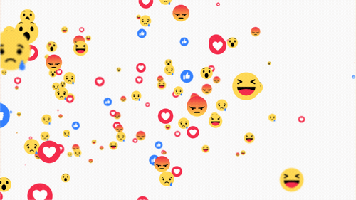
www.popbuzz.com
Notes:
Sim
In order to concentrate our analysis we choose to work with the top 4 mainstream media outlets based on interaction
An “interaction” in social media is direct involvement between the user and the post.
This includes all likes, comments, shares, and reactions.
We wanted to look at this because that’s how news spreads: one person shared a post, another person comments on it, a third person likes that comment, a fourth person sees that like and likes the post, the friends of that fourth person now sees the post. This is how social media tracks popularity and success.
In February 2016, Facebook introduced other types of reactions other than the like. They include the “heart”, “wow”, “sad”, “angry”, and “haha”

Slide 5
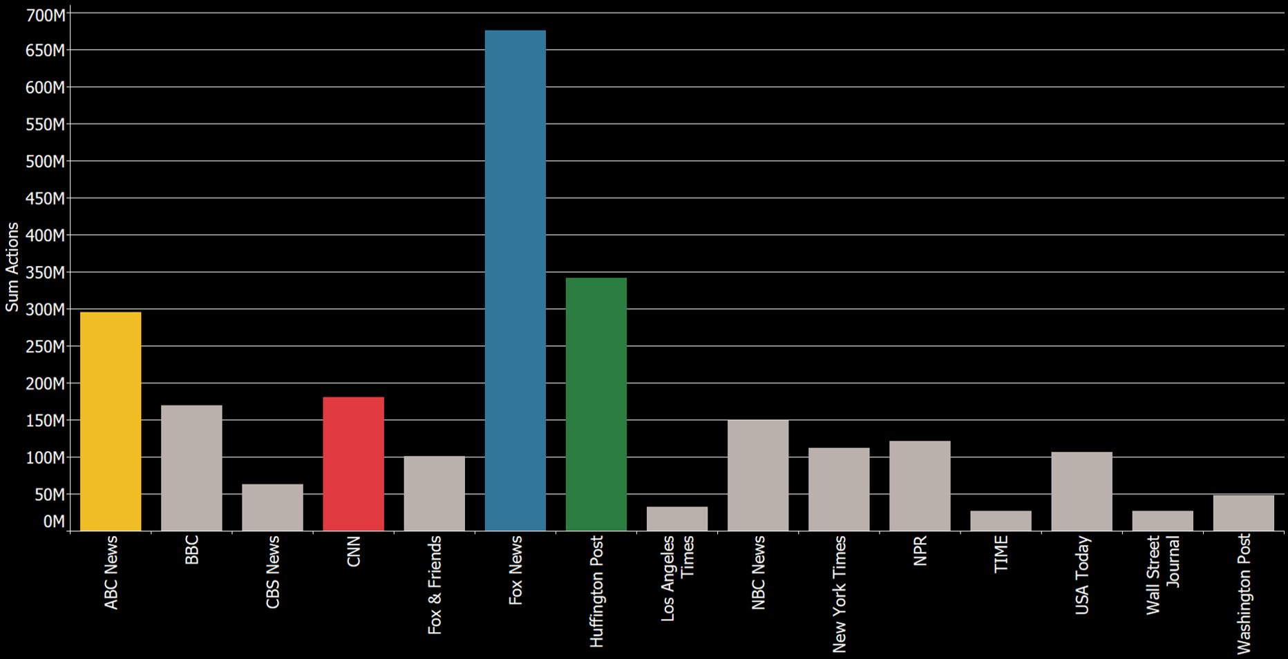
Notes:
Sim
This is a graph of all the news sources and their sum of total interactions, including shares, comments, likes, and other reactions
We can clearly see FOX news is clearly on top when you account for all the possible interactions within facebook, with HUFF Post and ABC News neck and neck for second and third, and CNN a little farther down, but still fourth. This is how we chose our top four news sources to focus on.
(Keep in mind, we did not have any data from CNN in 2012 or 2013 from the original dataset)

Slide 6

Goal
Improve REACH and CONTENT PLANNING of Huffington Post
Notes:
Allison
“Our goal is to provide information to social media managers in order to improve the REACH and CONTENT PLANNING of Huffington Post. We accomplished this by comparing the top four news sources (highlighted in the previous slide) based on the facebook interactions.”

Slide 7
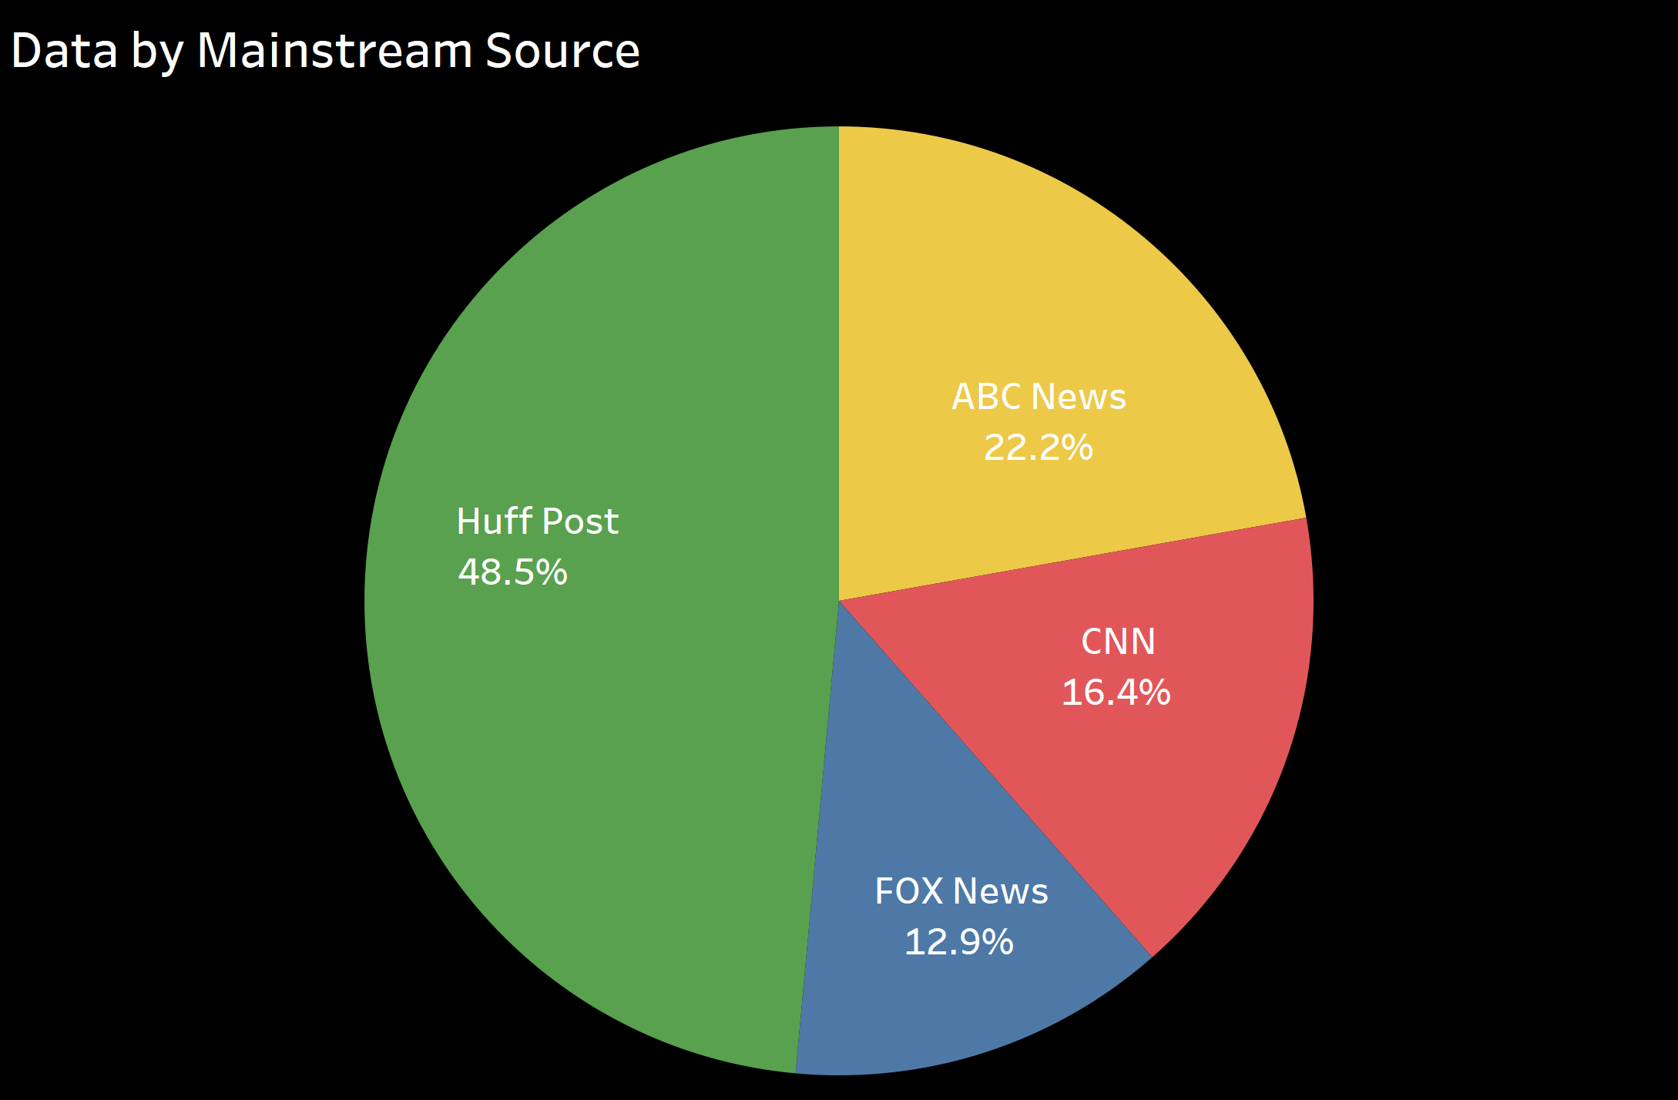
Notes:
Allison
“So we are going to get started by taking a look at this pie chart that is comparing the number of posts in general of the top 4 news sources. As you can see HuffPost has posted the most stories with 48.5%. This is why we decided to focus our findings on this particular mainstream news source.”

Slide 8
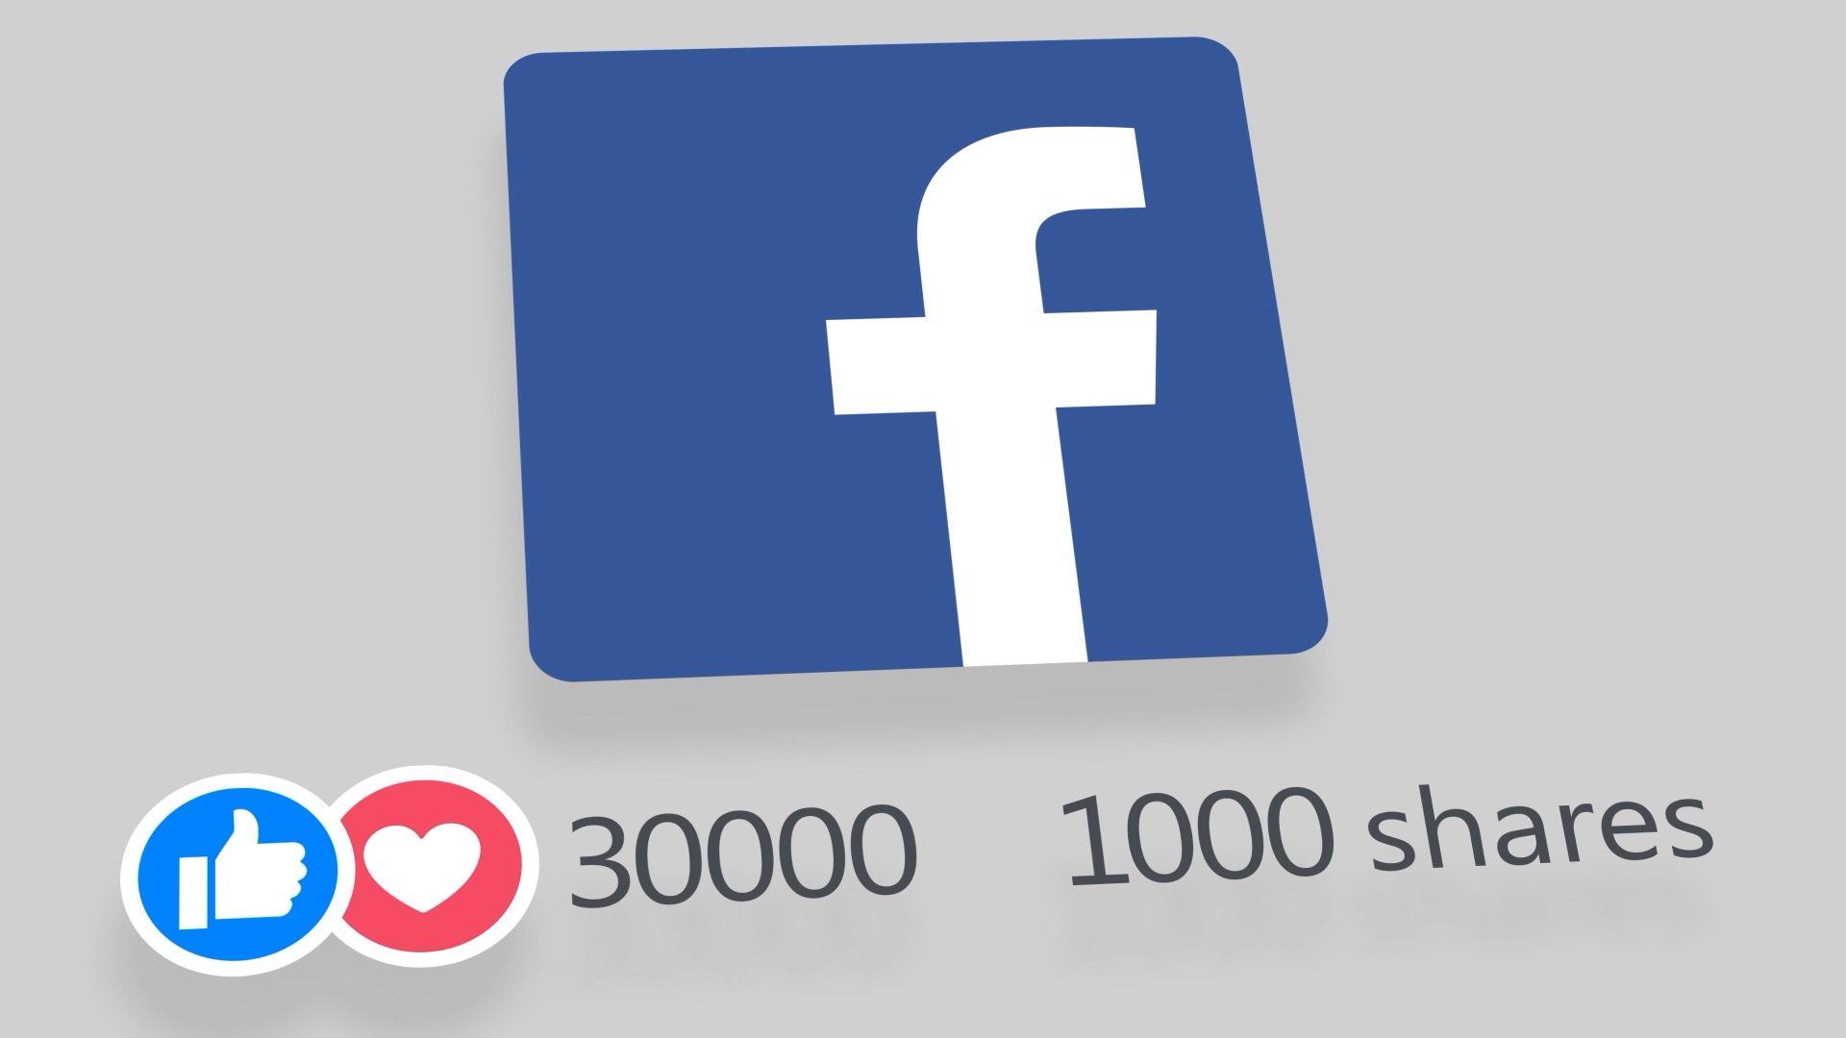
Reach
Shares and Comments
Number of Stories
Time of Posting
Notes:
Ileana
As we stated before will be conducting the analysis for Huff Post based of improving reach and content planning
For the analysis of Reach for Huff Post we will be focusing on the shares and comments, time of postings, and the type of posts

Slide 9
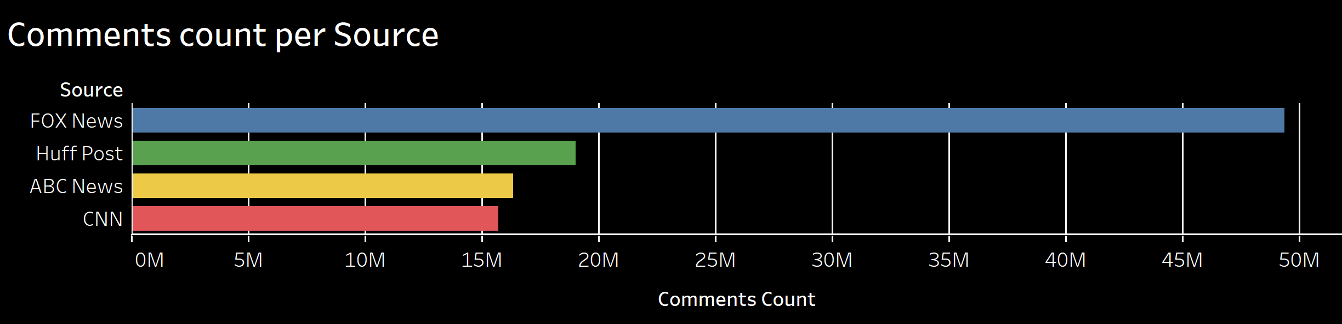
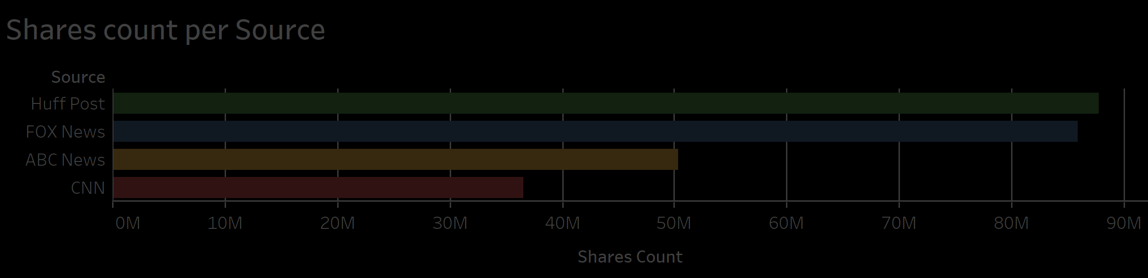
Notes:
Ileana
Let’s start with Analyzing the Comments and Shares per Source
The number of comments and shares and facebook posts are good measures of reach for the news sources
Of the two measures, Comments are better measure of reach since requires higher engagement on the post that just sharing
Sharing a post means higher exposure but is less interactive
The comments per source graph show that the direct competitor in terms of comment count for Huff Post is Fox news
Huff post leads the shares per counts

Slide 10
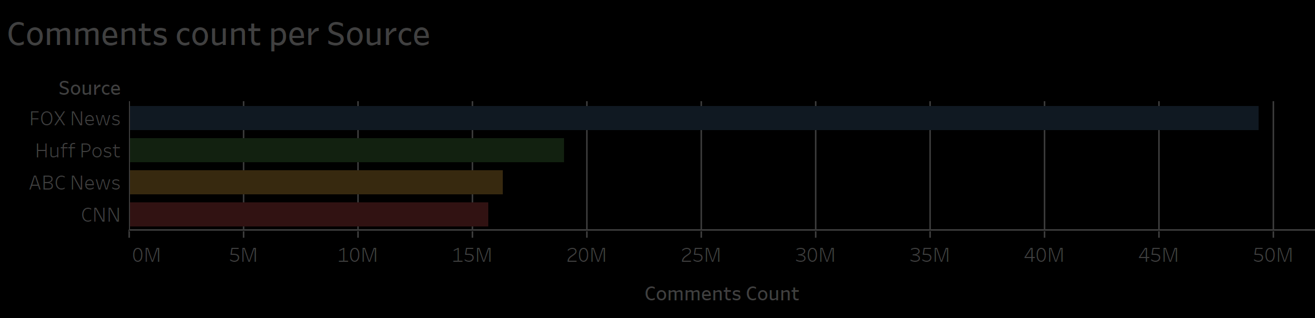
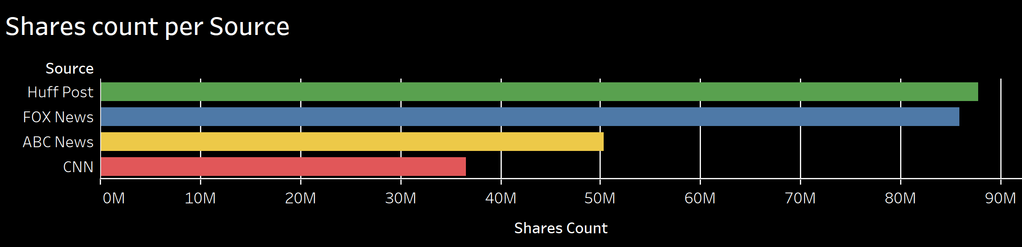
Notes:
Ileana
Let’s start with Analyzing the Comments and Shares per Source
The number of comments and shares and facebook posts are good measures of reach for the news sources
Of the two measures, Comments are better measure of reach since requires higher engagement on the post that just sharing
Sharing a post means higher exposure but is less interactive
The comments per source graph show that the direct competitor in terms of comment count for Huff Post is Fox news
Huff post leads the shares per counts

Slide 11

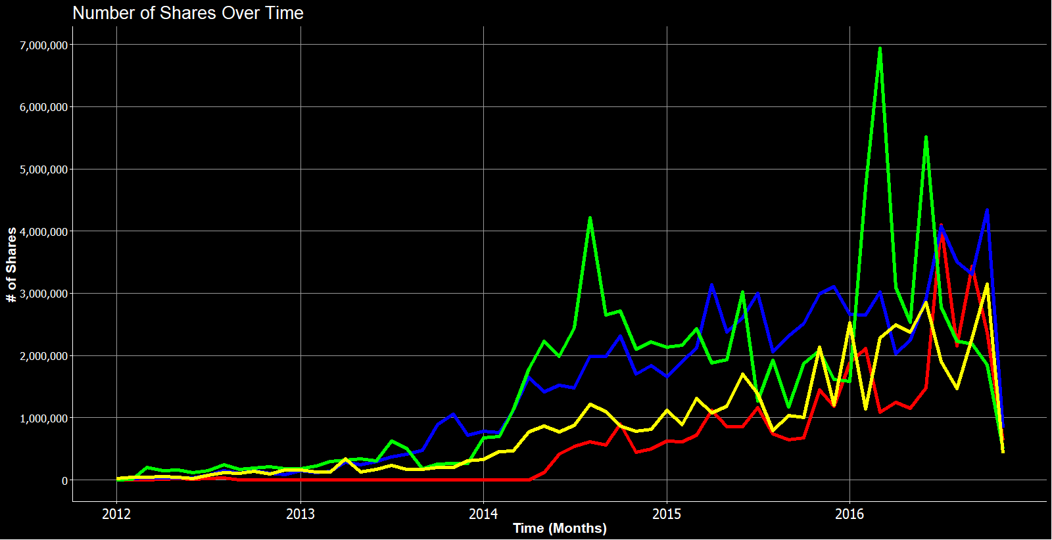
Notes:
Ileana
Continuing with the analysis of shares
Huff Post has had more of the share spikes, but FOX news comes in second most of the time.
CNN and ABC News has also increased their share-counts over the years, most notable after 2015.
However, Huffington Post started to fall behind on shares starting in July 2016

Slide 12
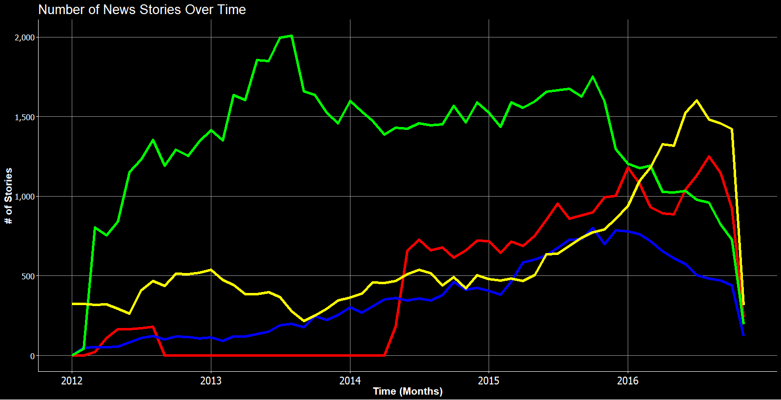
–– ABC News –– Huffington Post –– CNN –– FOX News
Notes:
Ileana
If we analyze the number of stories over time
Huffington Post dominated in the number of stories for a long time.
Started posting less and less starting in October 2015.

Slide 13
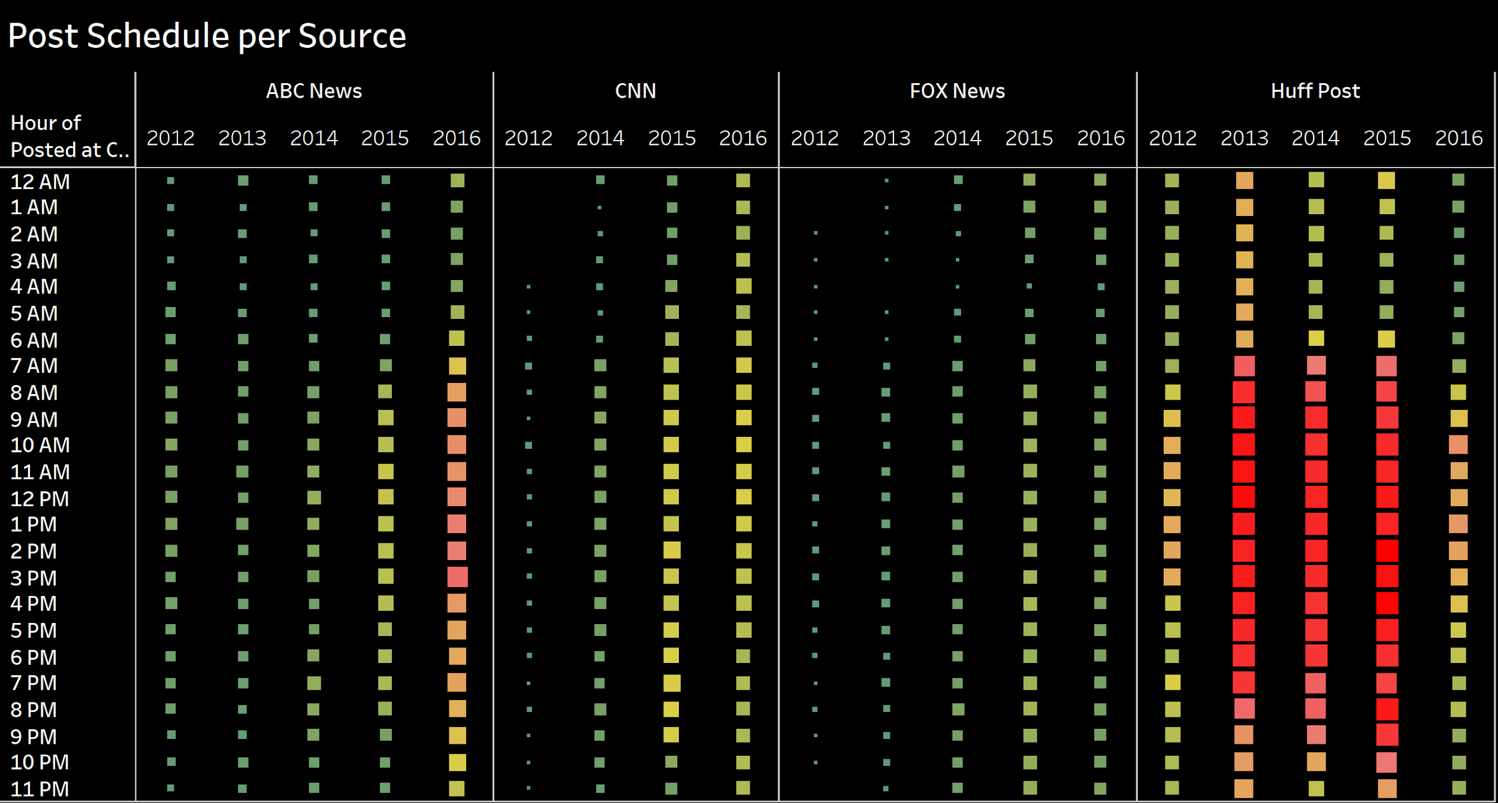
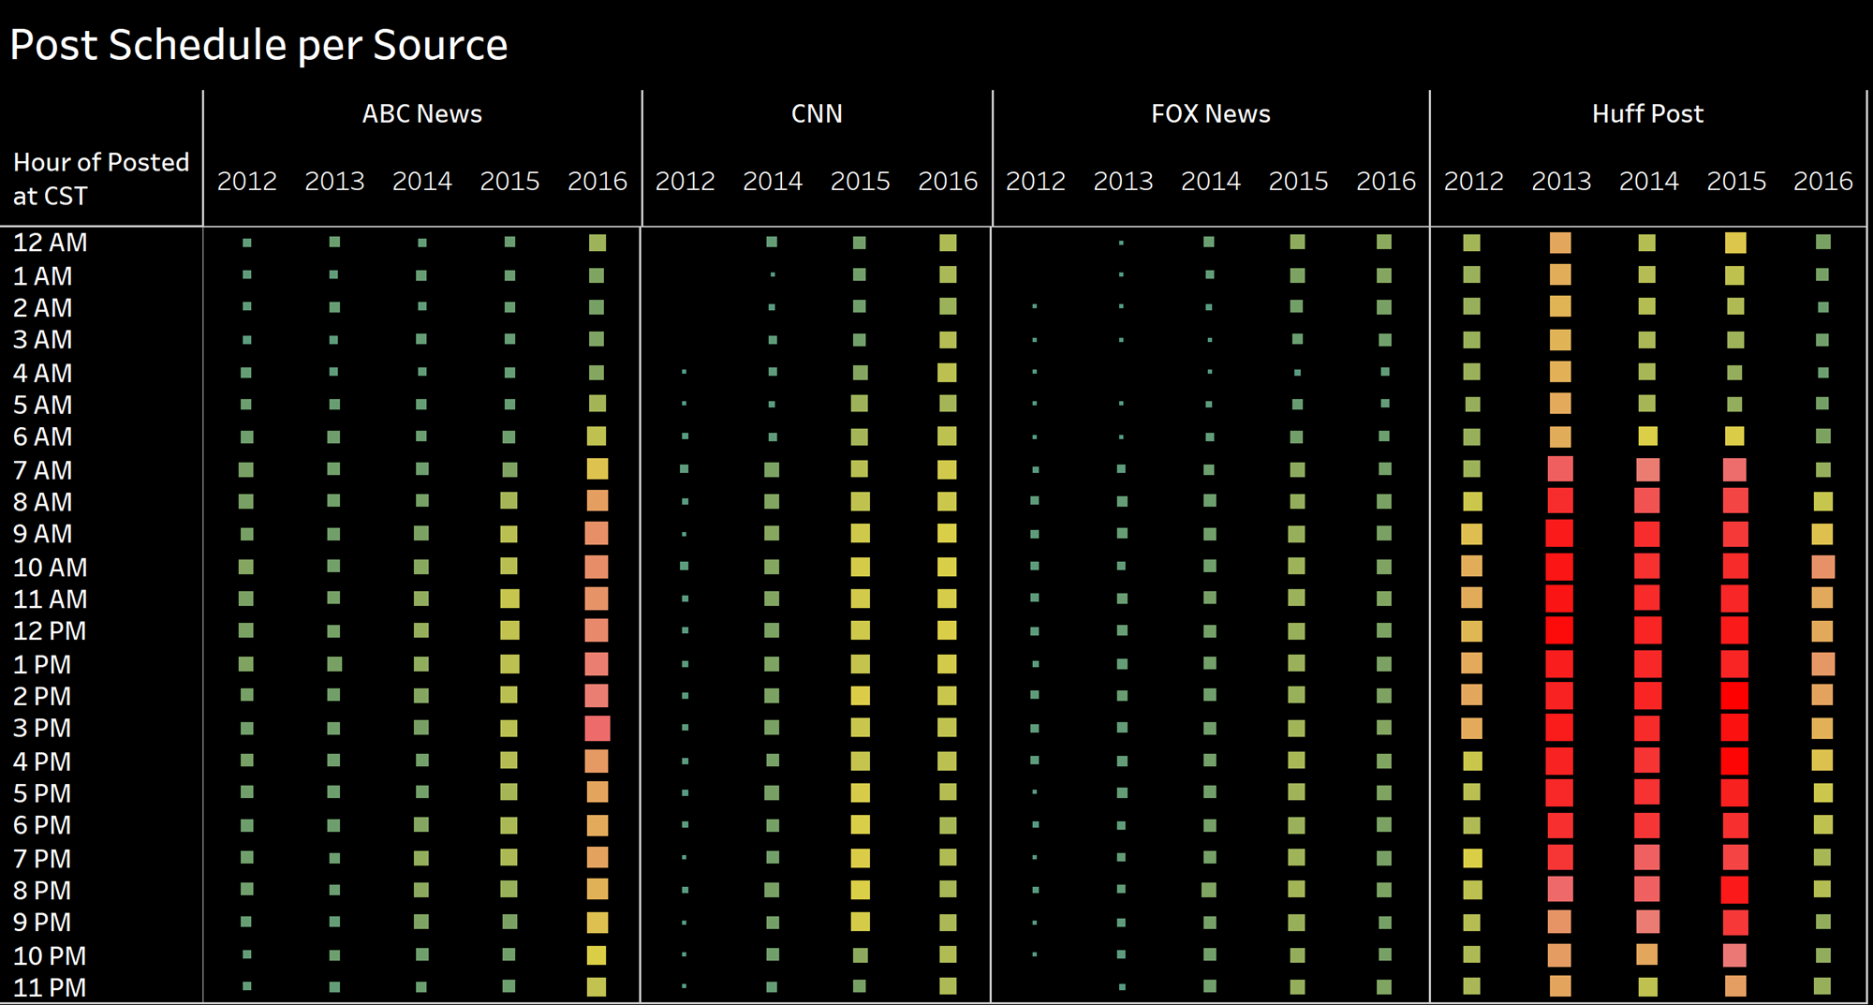
Notes:
Ileana
Here is a “heat map” of when each source has the most posts per hour in Central Time
Red squares show the highest amount of posting per hour
We can see that most of the posting is done between 7am and 9pm
Huff Post number of postings is significantly greater than the other sources, as supported from previous graphs
We also can appreciate that the number of posts increase per year for every source
Huff post tends to overpost

Slide 14
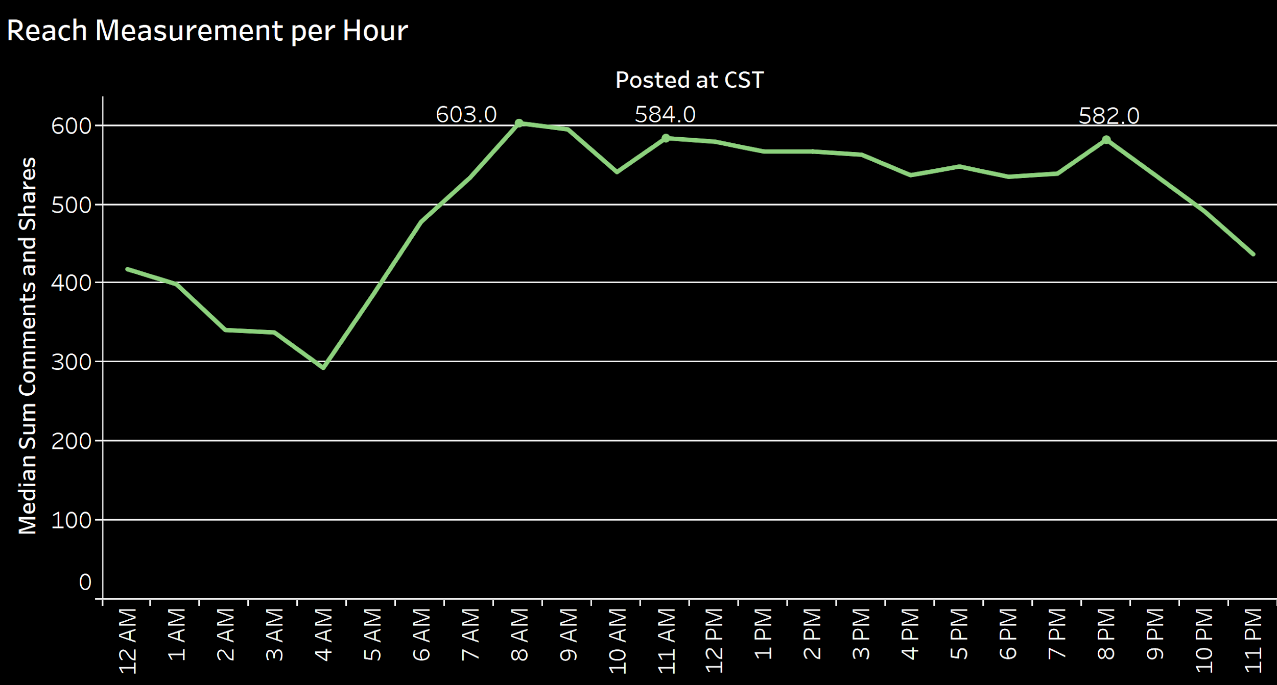
Notes:
Ileana
Since we are measuring reach in terms of shares and comments, the following graph shows the sum of the comments of shares for all sources by hour
Assuming that the sources will have optimal reach posting when the median number of comments and shares is higher, then the optimal times for postings are 8 AM, Followed by 11 AM and lastly 8 PM

Slide 15

Content Planning
Reactions (Like, Love , Angry, Sad, Thankful, Wow)
Coverage of a specific event (Shootings)
Notes:
Sim
Usually businesses come up with a strategy that guides future news development to deliver against a specific business objective and goal, which for us is helping the Huffington Post with managing their Facebook.
Content Planning is the tools and techniques companies use to reach this goal. Timing, promotion, communication, presentation, optimization. These are all things that are critical when it comes to managing social media.
For our context, we use the reactions (Like, Love , Angry, Sad, Thankful, Wow) to see the popularity of these news sources’ content in terms of what consumer interact with
We also decided to focus our posts on the coverage of a specific event (Shootings) in terms of competitive advantage and wining consumers. This is because this topic is very important to the American people and in our preliminary analyses, we made word clouds and found “shooting” was a term that was often used.

Slide 16
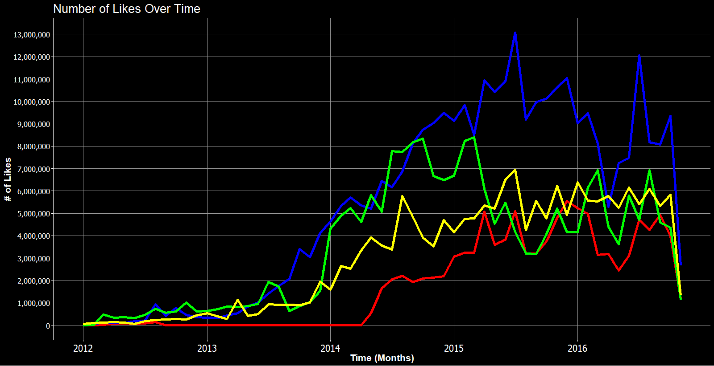
–– ABC News –– Huffington Post –– CNN –– FOX News
Notes:
Sim
When looking at the number of likes over time, all news sources show an increase in the number of likes; however, we can see that Fox News dominates.
Prior to March 2015, Huff Post was a close second to Fox News.
After March 2015, Huff Post and ABC News began a trade-off
CNN tends to have the least number of likes in comparison to the other three news sources.

Slide 17
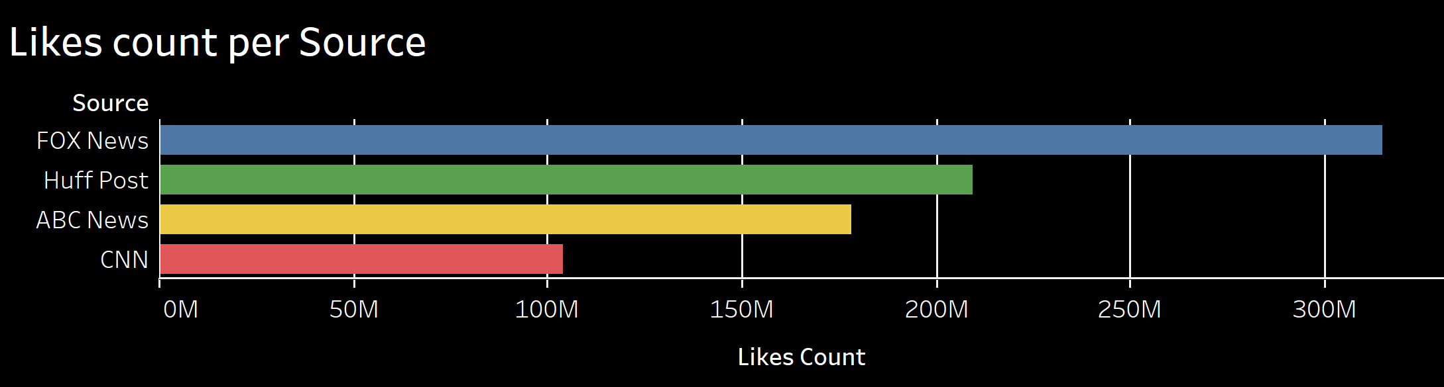
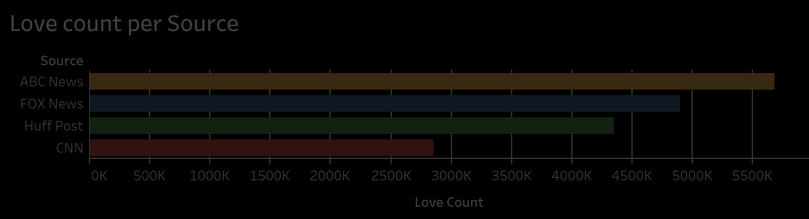
Notes:
Sim (rewrite a little smoother)
We have each reaction with respect to their specific news source and the sum of their total counts over time.
The other reactions we see outside of likes were introduced in late February 2016, but given that they appear in our dataset for only about 9 months they still have a significant impact on content planning.
FOX news has the most likes, where ABC News has the most love counts, and CNN is last for both by a significant margin.
Sources will like to have more positive reactions, so the algorithm keep showing viewers

Slide 18
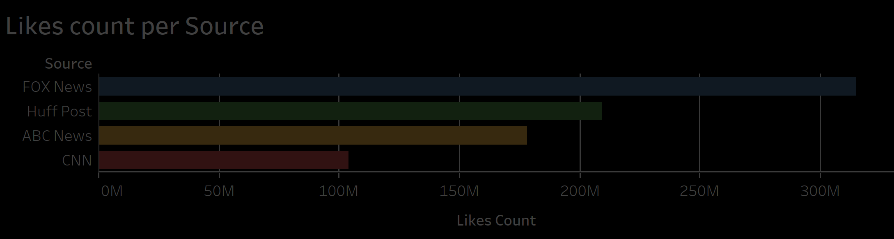
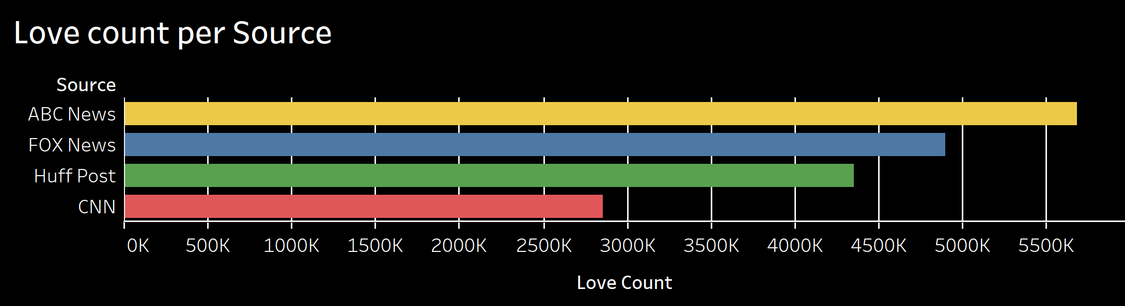
Notes:
Sim (rewrite a little smoother)
We have each reaction with respect to their specific news source and the sum of their total counts over time.
The other reactions we see outside of likes were introduced in late February 2016, but given that they appear in our dataset for only about 9 months they still have a significant impact on content planning.
FOX news has the most likes, where ABC News has the most love counts, and CNN is last for both by a significant margin.
Sources will like to have more positive reactions, so the algorithm keep showing viewers

Slide 19
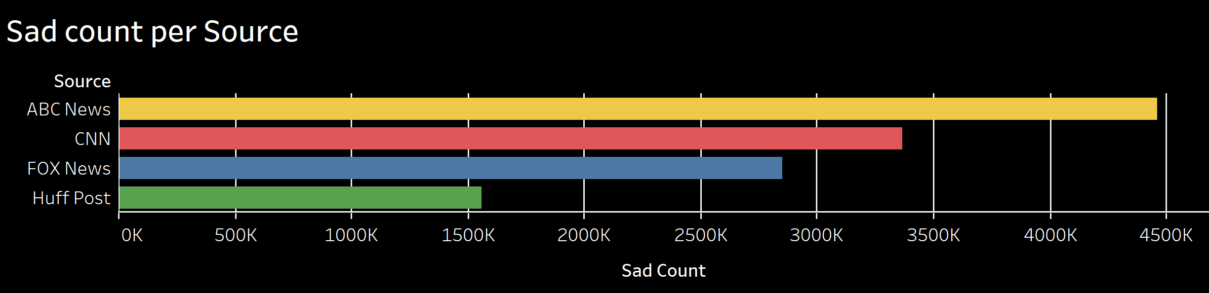
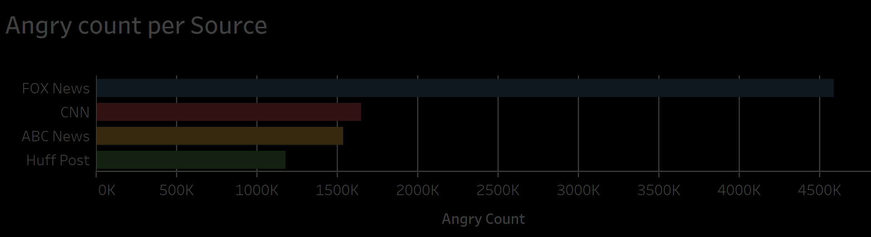
Notes:
Sim (rewrite a little smoother)
ABC News and FOX news come out on top for sad and angry, respectively, but for these two reactions CNN is second, with the Huffington Post absolutely last. With the “angry count”, in context this is actually a good thing, especially since its relatively close to CNN and ABC News. This shows that the negativity received by their posts are on par with most of the news sources. And the sad count could be viewed the same, but is has almost half of the reactions that FOX news has.

Slide 20
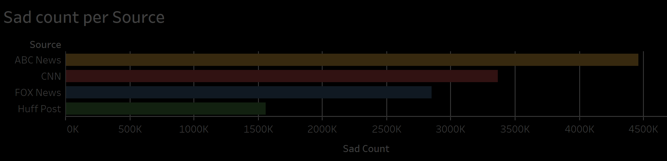

Notes:
Sim (rewrite a little smoother)
ABC News and FOX news come out on top for sad and angry, respectively, but for these two reactions CNN is second, with the Huffington Post absolutely last. With the “angry count”, in context this is actually a good thing, especially since its relatively close to CNN and ABC News. This shows that the negativity received by their posts are on par with most of the news sources. And the sad count could be viewed the same, but is has almost half of the reactions that FOX news has.

Slide 21
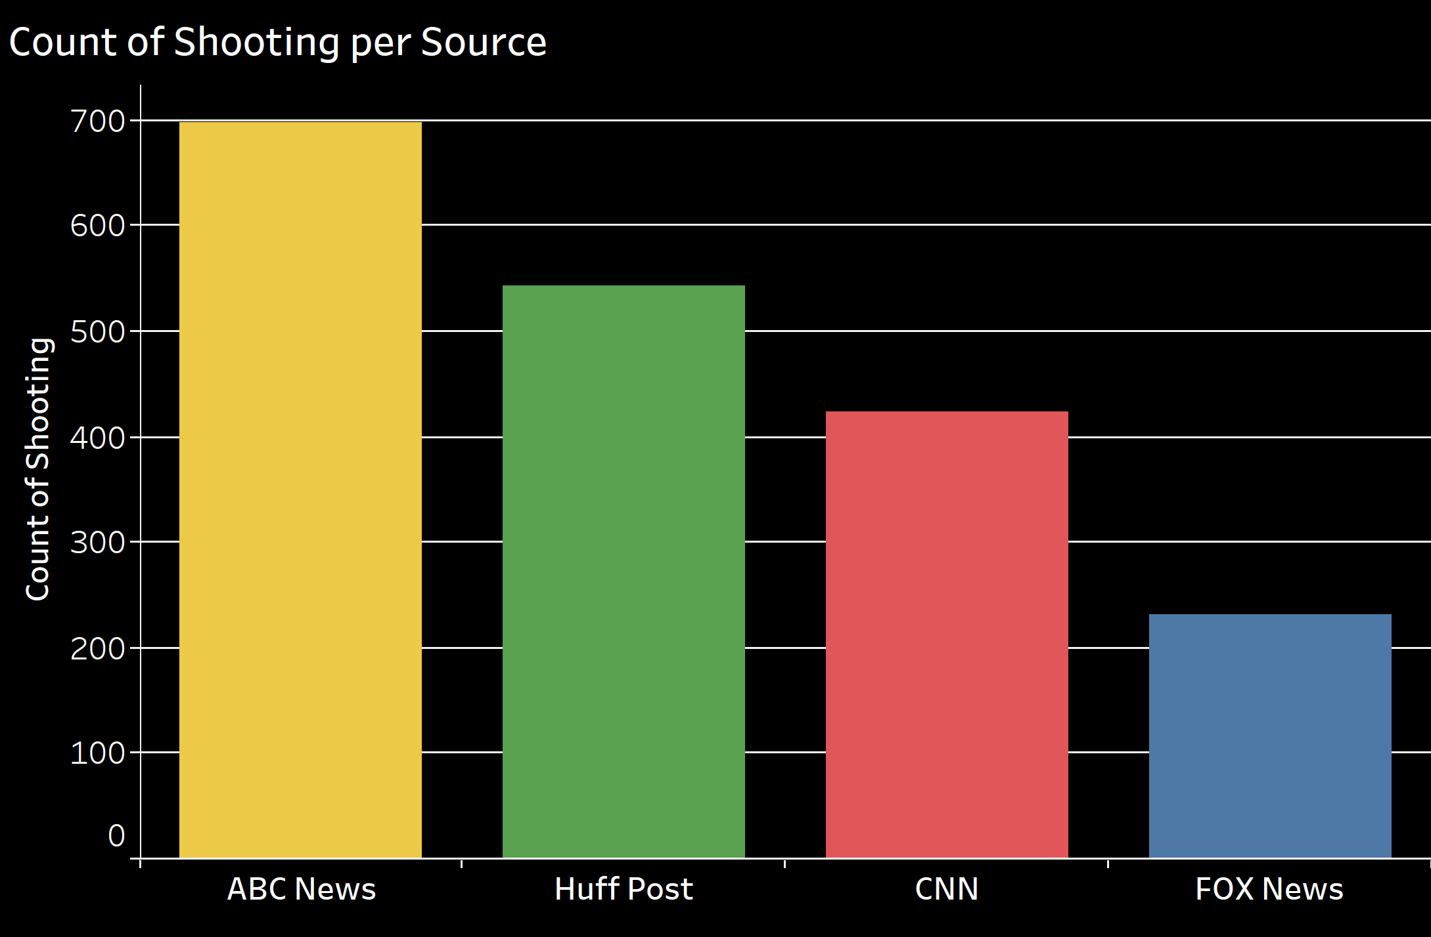
Notes:
Ian
The Second level of content analysis for Huff Post comes from analyzing the coverage of a specific event: Shootings
According to the count of shootings per source, we can see that ABC News
Can display this overtime (transition)

Slide 22
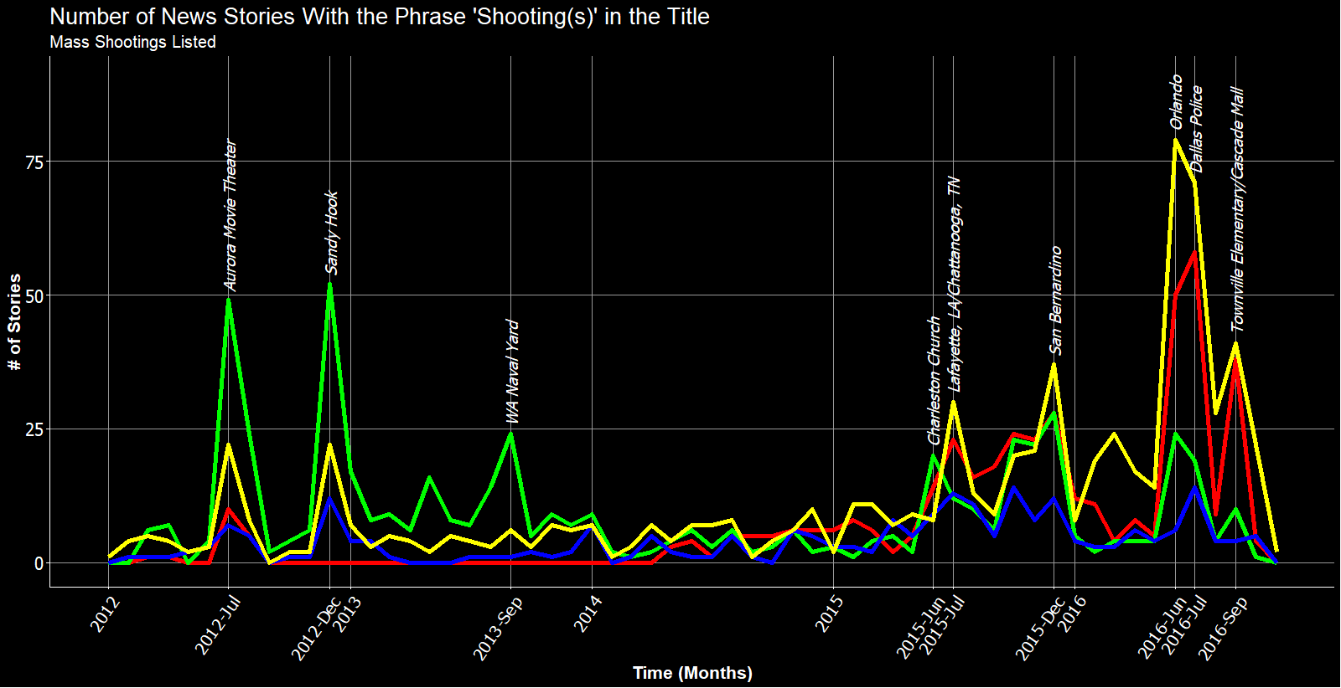
–– ABC News –– Huffington Post –– CNN –– FOX News
Notes:
Ian
In recent years, Huffington post has reported less on shootings.
Also has fallen behind in reporting mass shootings.

Slide 23
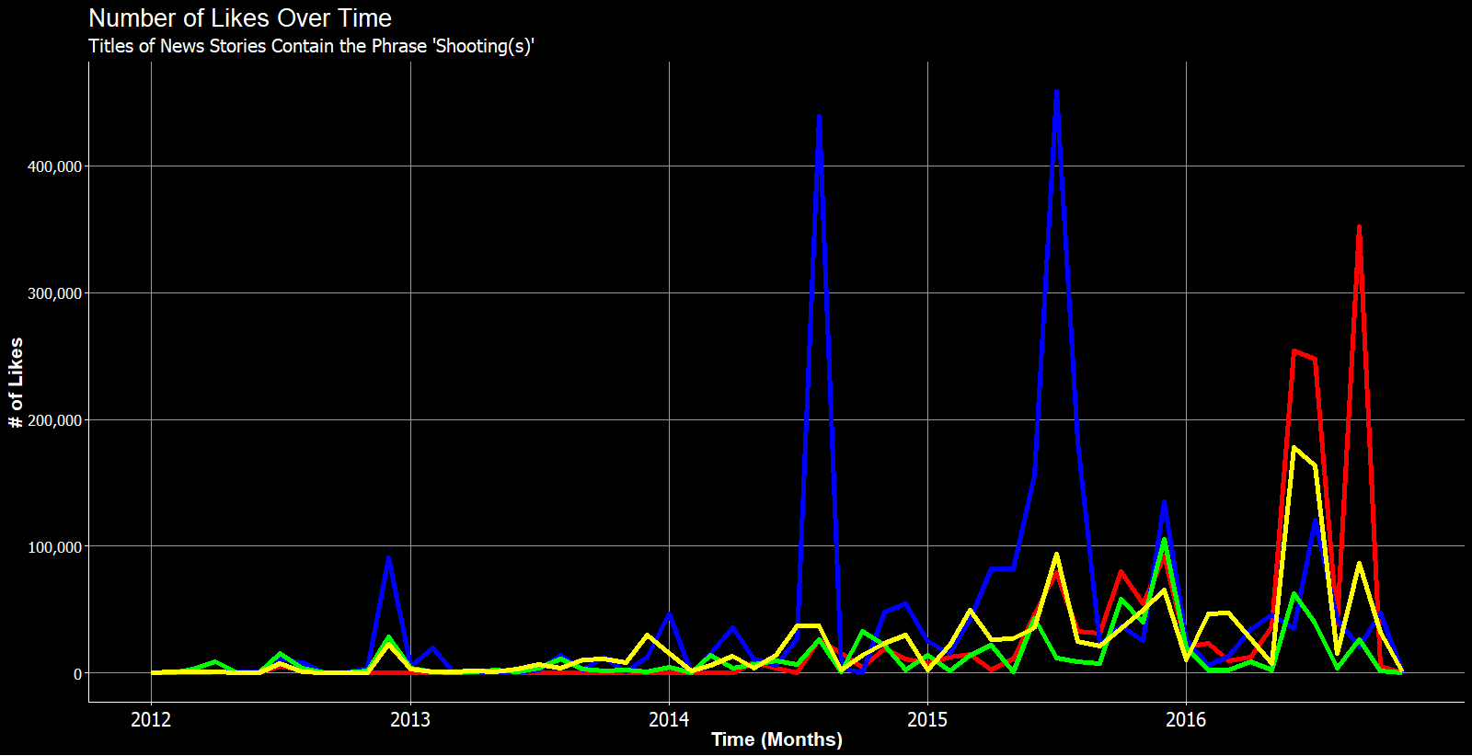
–– ABC News –– Huffington Post –– CNN –– FOX News
Notes:
Ian
Huffington Post has never lead in interactions with its audience in terms of likes when reporting shootings.

Slide 24
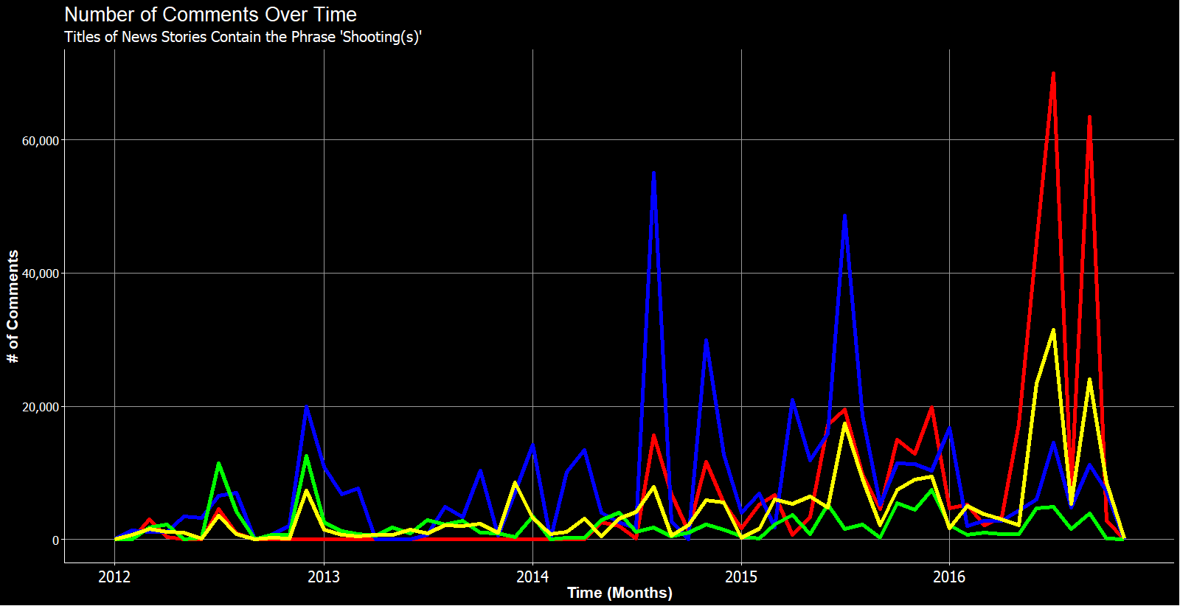
–– ABC News –– Huffington Post –– CNN –– FOX News
Notes:
Ian
And in comments (reporting shootings)

Slide 25
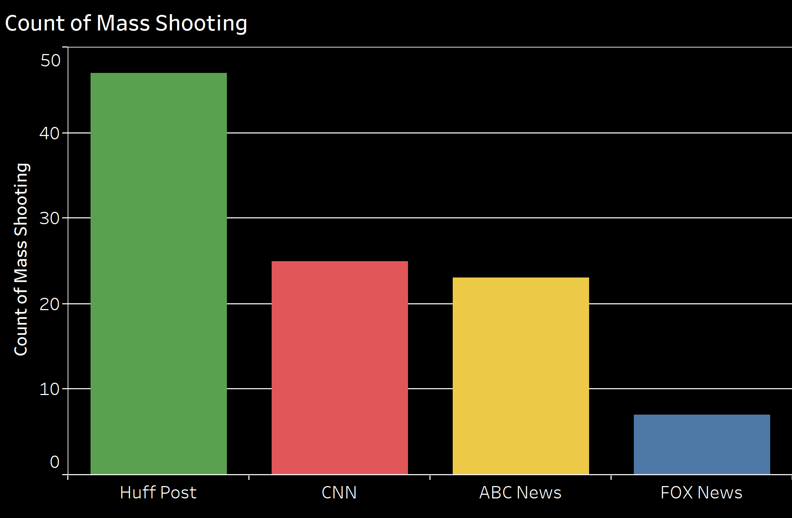
Notes:
Allison
To go deeper into the analysis we can see the differences in coverage between Mass Shootings,School Shootings, and Police Shootings
Huff Post posted the most stories that contained the phrase “Mass Shooting”
Fox News posted the least number of stories

Slide 26
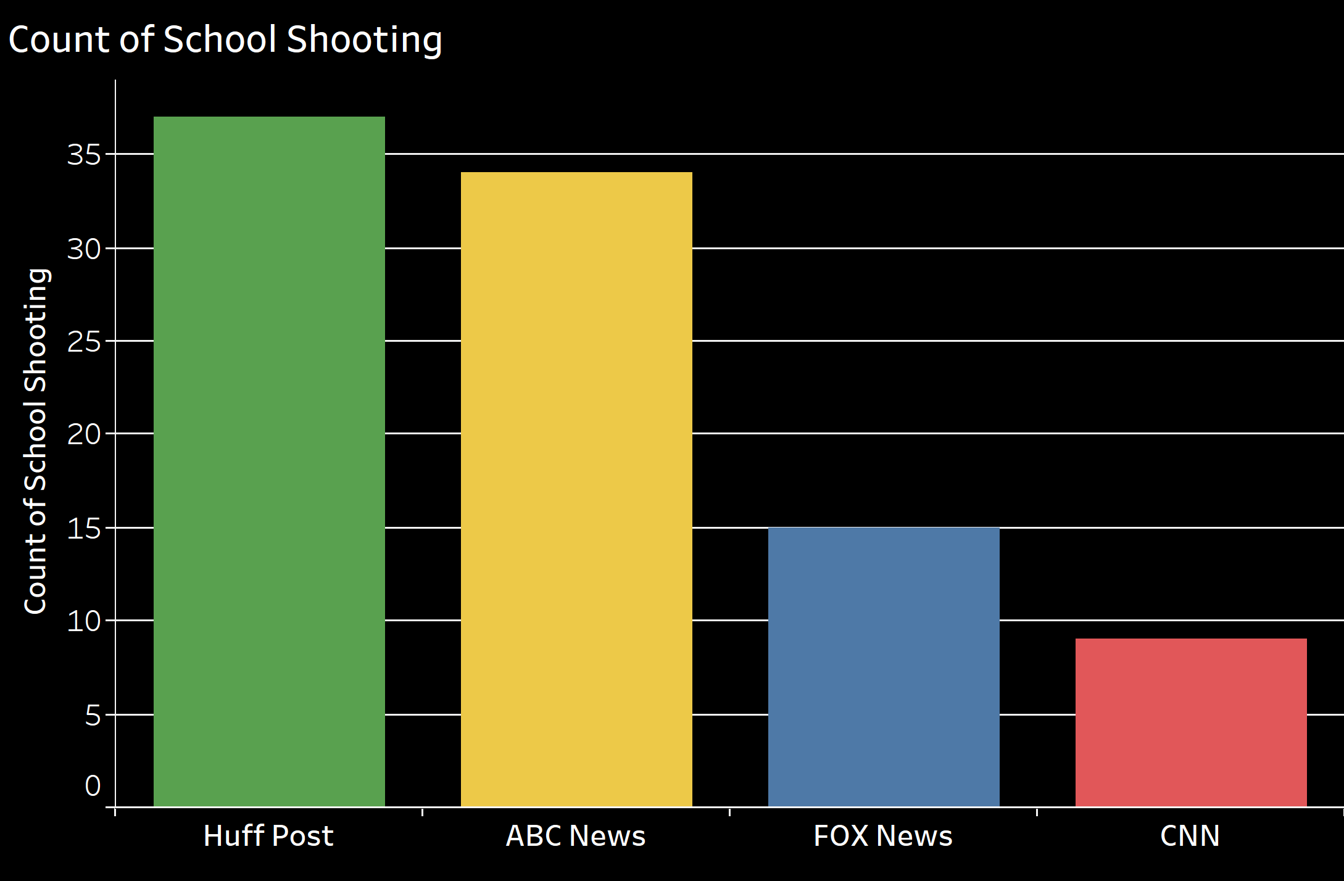
Notes:
Allison
contrary to shootings….
This is the count of number of posts containing the world “School shootings”
Huffpost is the source with the highest amount of coverage of School shootings based on their posts

Slide 27
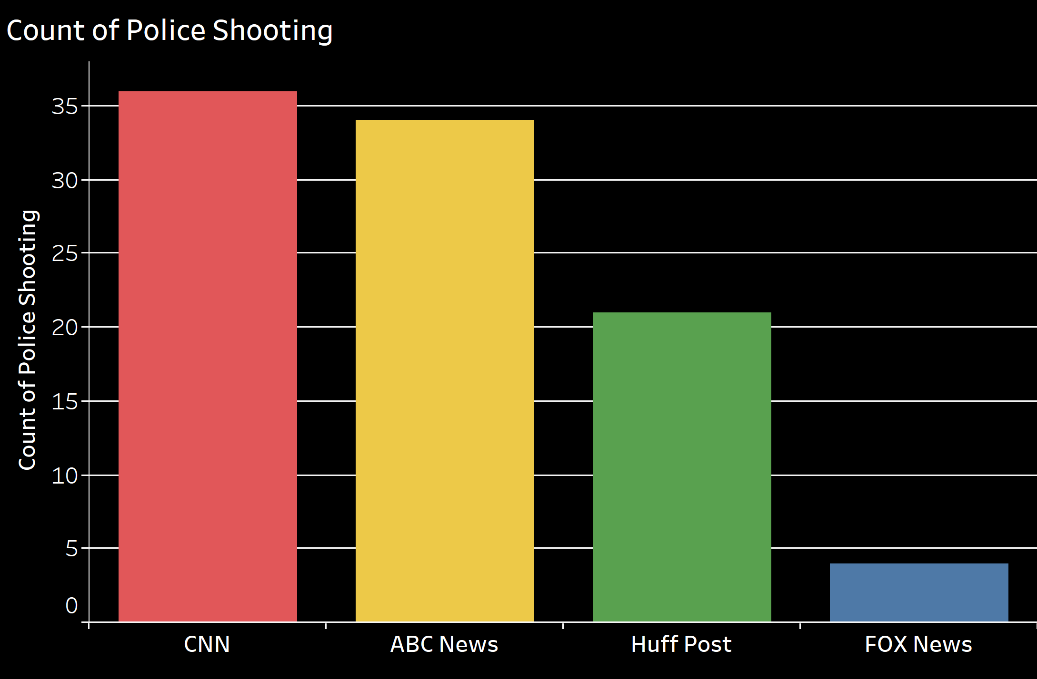
Notes:
Allison
This is the count of number of posts containing the world “police shooting”. CNN and ABC news took this to the next level, each producing over 30 stories.CNN in know for being a more formal news outlet and has more input on topics that can be politicized. HUFF Post also was serious with the topic, with 20 stories. But FOX News barely brought the news to light with less than 5 stories over the course of 4 years.
Huffington Post at least had some traction with this, giving it a head start over FOX News.

Slide 28
In Conclusion...
Notes:
Allison
In term of covering of shootings, Huffington Post has sufficient coverage to be considered significant. HOWEVER...

Slide 29
Notes:
The lack in interactions with their posts, specifically the number of comments...

Slide 30
Notes:
As well as the frequency of their postings has made it difficult for them to compete with the other news sources.

Slide 31
Notes:
We suggest Huffington Post decrease the amount of posting and focuses more on the timing (8AM, 11AM, 8PM) and quality of the content of their postings in order to improve their reach and number of interactions. This in turn will then enable them to better compete in the market.

Slide 32
Questions?
Notes:
“We would like to thank everyone for your attention this afternoon as well as Dr. Malshe (Malshay) for the opportunity to work on this real-world dataset. We can now open the floor to any question you may have.”

